Slide 1
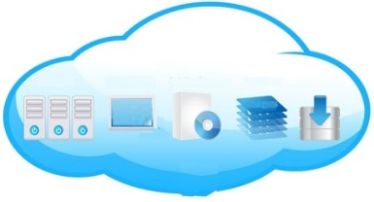
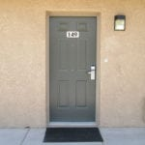
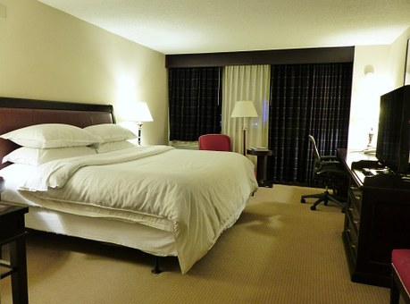
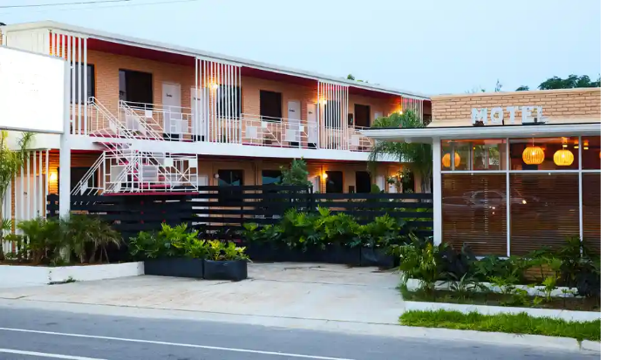


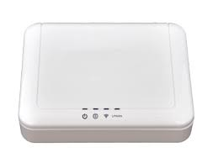
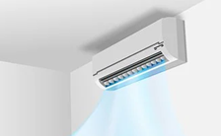
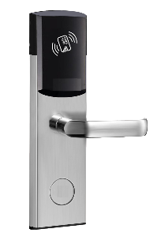



Wireless mesh network based Smart Lock, Lighting & HVAC Control & Environmental & Presence Sensing in Motels & Hotels
Cloud/On premise
Wi-Fi / Cellular
Wireless mesh
Gateway
RF node for lock control
RF node with lighting control
RF node with environmental and presence sensors
RF node for HVAC control
LED fixture

Slide 2
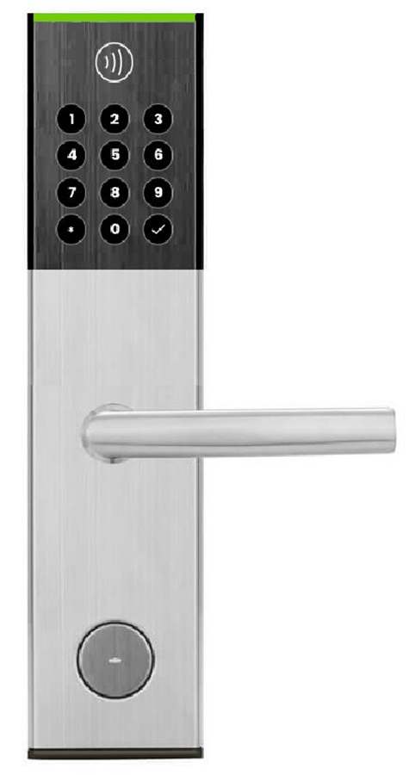



Portal in Cloud
Each lock has a RF node embedded inside which is part of a mesh network.
Gateways in Hotels
RF nodes
Lock can be opened by
RFID card
Number entered through smart phone
Number entered through keypad – to be developed
RF nodes
Locks
RF nodes
Locks
Locks

Slide 3
Implementation
The smart lock project for hotels involves providing the facility for the guest to open the allotted room using
1. RFID card
2. Authentication key using web app (no phone app required)
3. secret number using the keypad on the lock
When a customer checks in, the hotel will allot the guest a room and provision a rfid card with a unique key using an application and rfid writer.
Simultaneously a authentication key is generated and given to the customer along with the rfid card.
The unique rfid key and an authentication number is sent to the lock RF board of that room through the cloud, gateway and mesh network.
When the guest reaches his room he can open the lock
1. Using the rfid card issued to him - this operation is local and is not dependent on installed the wireless mesh.
2. Using Web app. Open the customer portal in the browser and authenticate himself. He can then select open door from the menu.
On selecting the command the customer portal send the message to the gateway located in the hotel and then the gateway forwards the message to the particular lock through the mesh network and the lock opens.
The current implementation -firmware on the RF board and middleware on RPi - has the provision for methods 1 & 2.
The method 3 needs to be implemented.

